Slide 1


Project name: FET Control Box For ECEN Power Electronics Class Team members: Luke, Max, Sydney, Jacky

Slide 2
Project description (use pictures and diagrams to describe)
Problem statement: The FET box was created to aid in power electronics education (i.e. ECEN 438) and research. However, it was designed in 2003, so replacement parts cannot be ordered due to no longer being manufactured.

Slide 3
Project description (use pictures and diagrams to describe)
Solution proposal:
Modernize the previous design while keeping the design robust and easy to use.
Add new features and improve upon existing features.

Slide 4
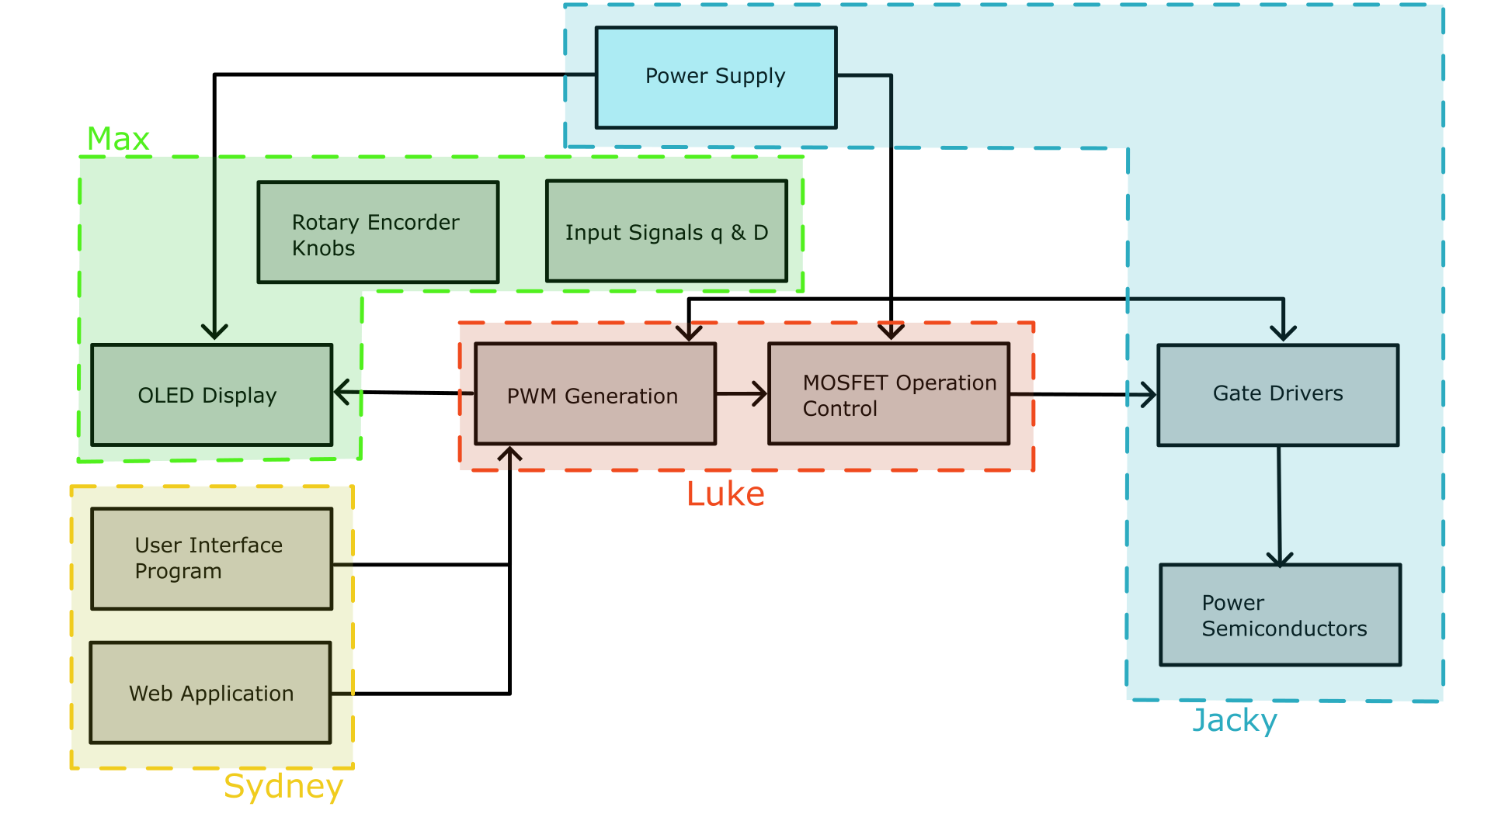
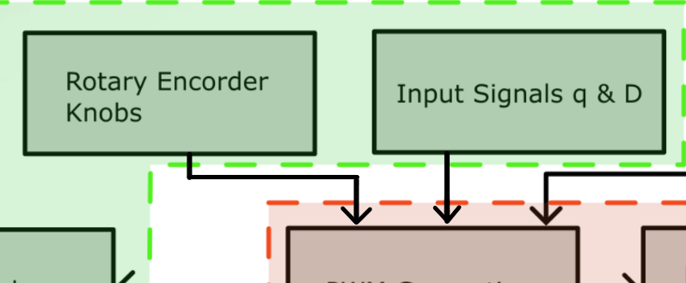
Diagram of subsystems and interface

Slide 5
-Power Supply Subsystem-
Jacky Chen
Accomplishments since the last presentation <26> hrs | Ongoing progress/problems and plans until the next presentation
<10> Power Output/Gate Drivers Schematic <2> Crowbar circuit integration <6> Power Supply Schematic <8> Parts research to replace old parts | Finalize power supply schematic Finish crowbar circuit schematic PCB design

Slide 6
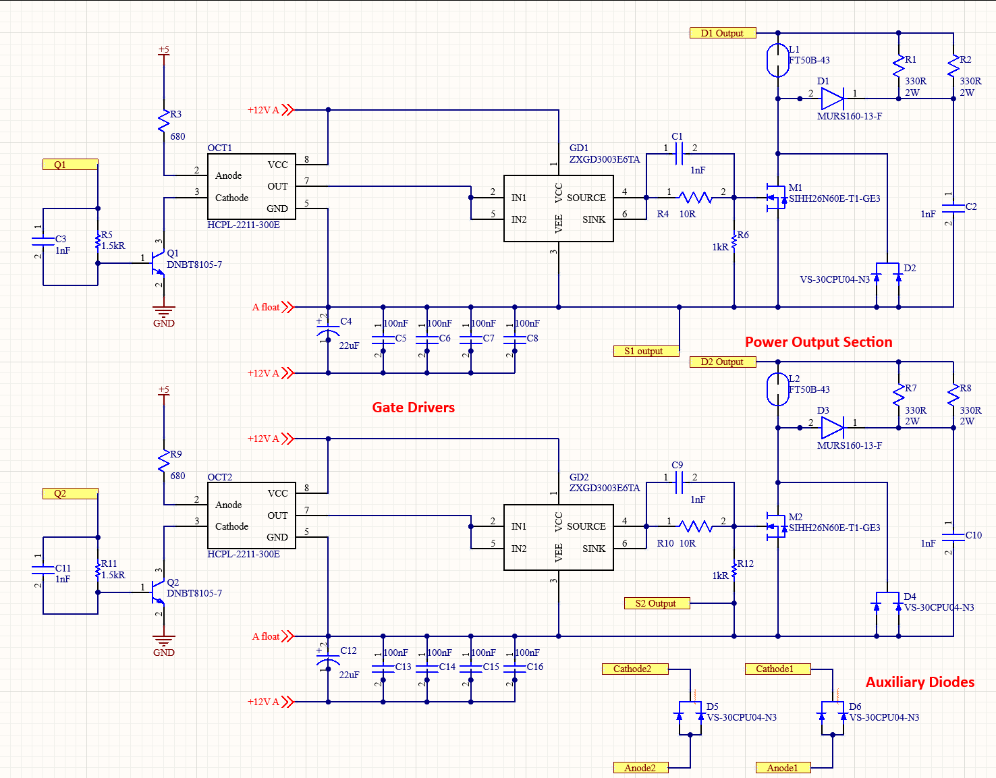
-Power Supply Subsystem-
Jacky Chen

Slide 7
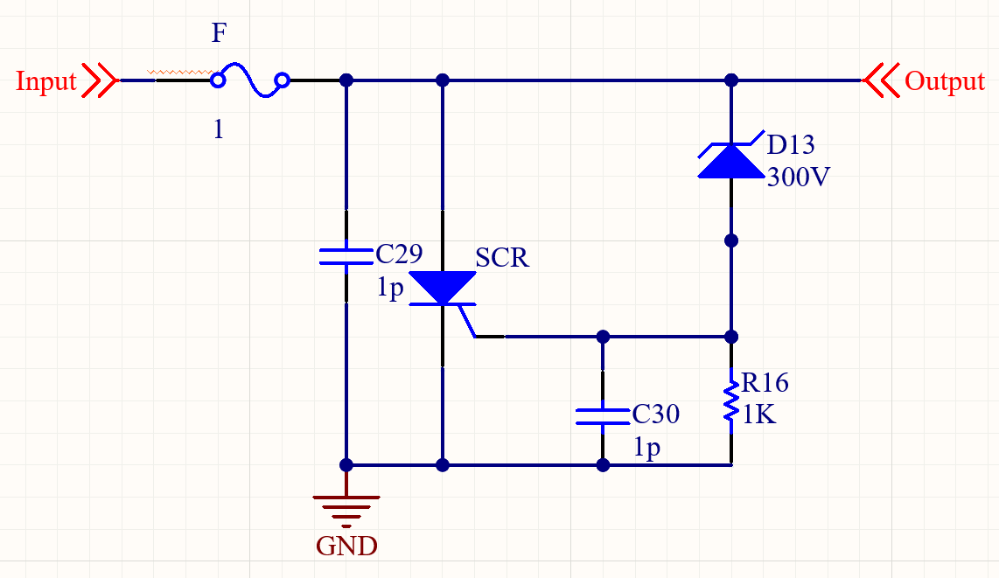
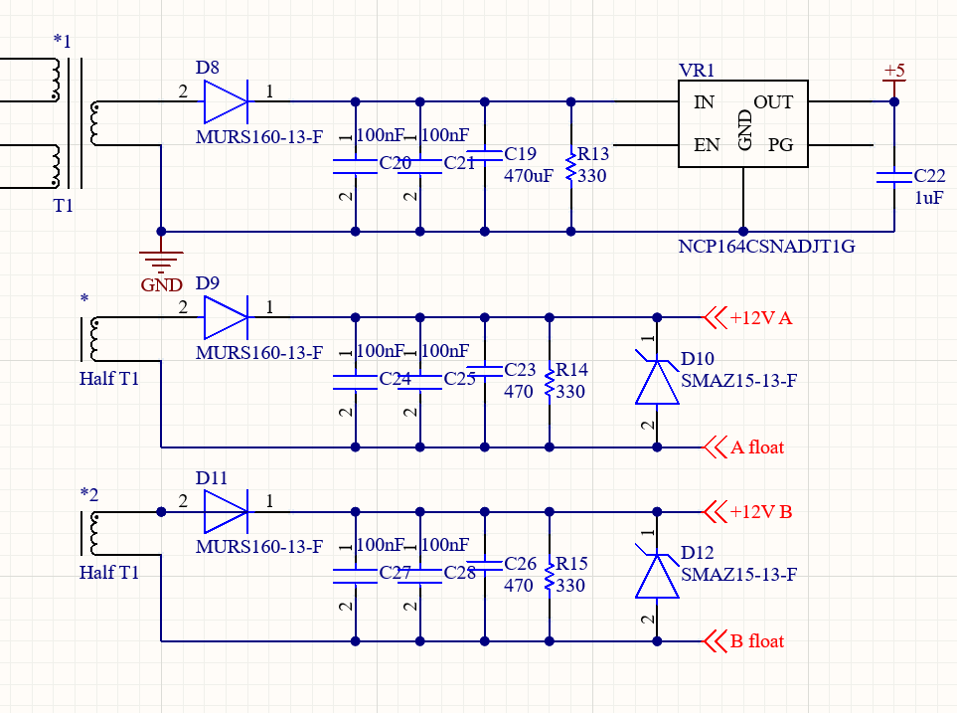
-Power Supply Subsystem-
Jacky Chen
Crowbar Circuit
Features:
Protects the device by bringing down voltage when it exceeds 300V.
Added redundancy in case the digital system fails to prevent overvoltage.
Power Supply

Slide 8
-UI & Application Subsystem-
Sydney Naddy
Accomplishments since the last presentation <26 hrs> | Ongoing progress/problems and plans until the next presentation
<9> Lab <4> Familiarization and experimentation with Matlab <8> Writing SCPI commands <5> Designing UI to execute commands and easy for students visualize and analyze | Ongoing Progress Switched to Matlab instead of Excel and Winforms for UI & SCPI command code per sponsors request Continuing to add SCPI commands and improve UI to implement all commands Problems switching to a different program created a setback however I am not concerned with the timeline

Slide 9
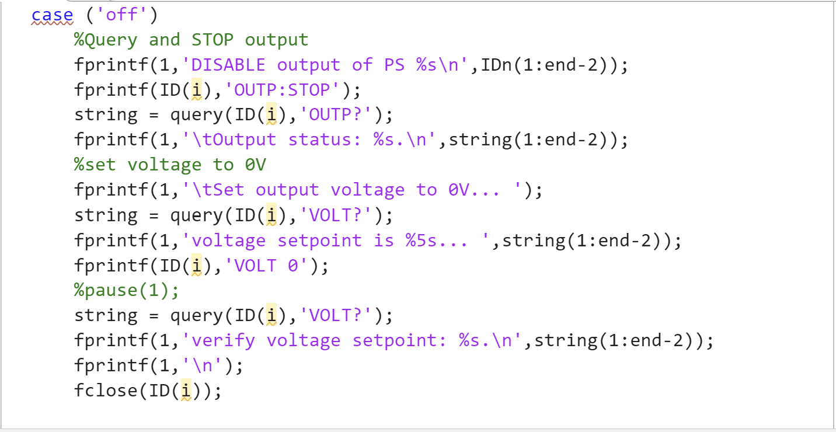
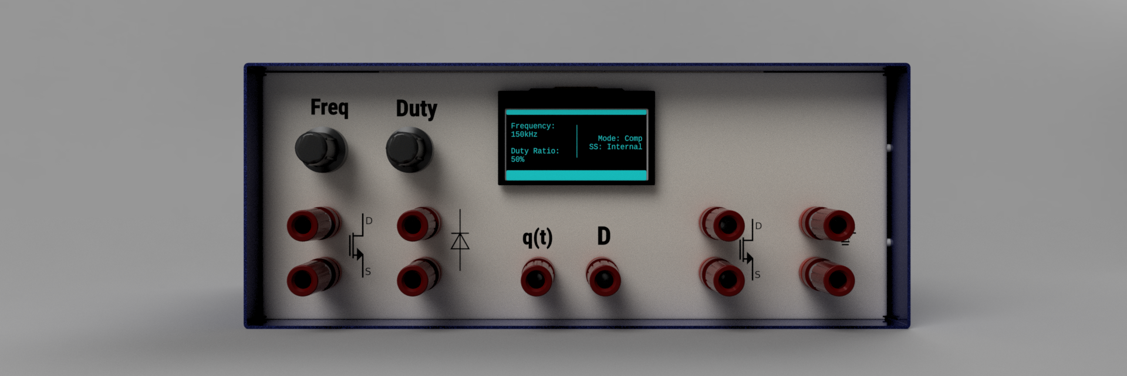
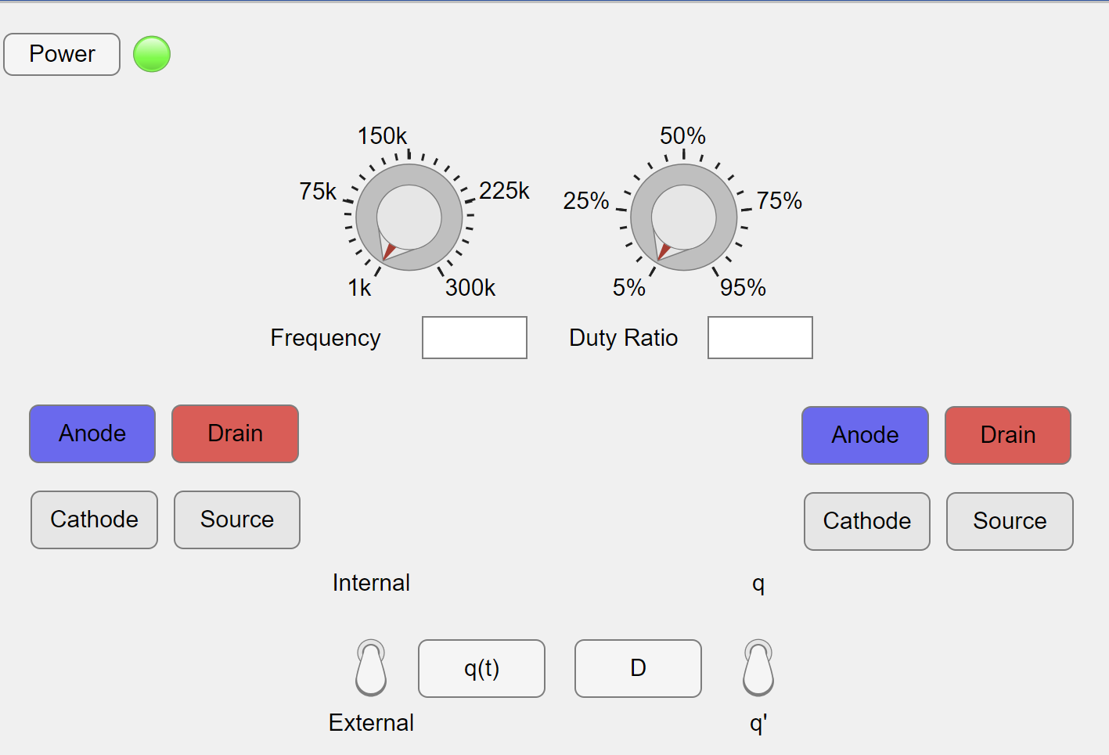
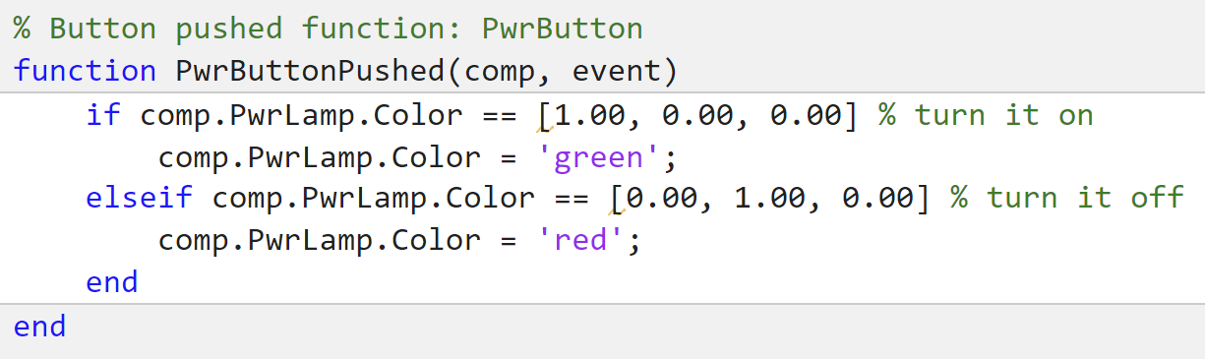
-UI & Application Subsystem-
Sydney Naddy
Power OFF SCPI Command
Proposed Front Panel
UI Matlab Front Panel
Matlab Code for UI Components

Slide 10
-Microcontroller Subsystem-
Luke Bethancourt
Accomplishments since the last presentation <29> hrs | Ongoing progress/problems and plans until the next presentation
<9> Lab <10> Completed PWM generation <3> Implemented 3 operation modes <5> USB communication <2> Microcontroller PCB | Ongoing progress: USB communication External q and D signal and Control mode buttons firmware PCB Design Problems: properly setting up the USB communication is much harder than anticipated

Slide 11
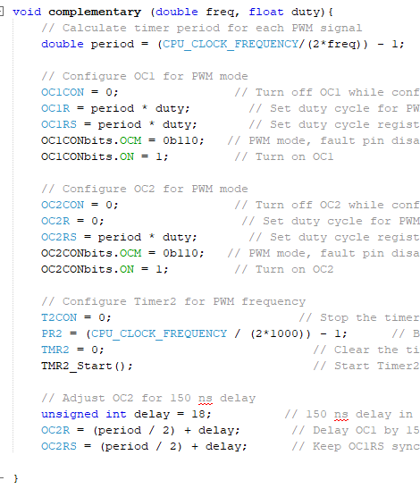
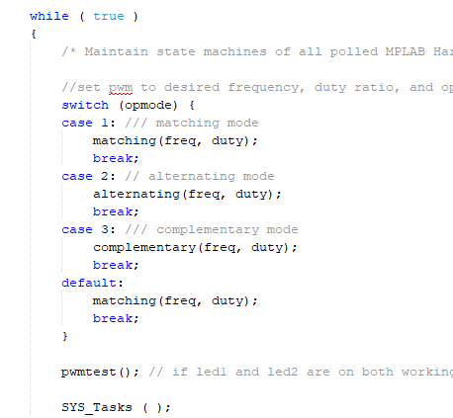
-Microcontroller Subsystem-
Luke Bethancourt
Sample of PWM generation code
a

Slide 12
-I/O Subsystem-
Max Garza
Accomplishments since the last presentation <14> hrs | Ongoing progress/problems and plans until the next presentation
(2) Parts Selected (4) Encoder firmware completed (8) Display firmware designed | Populate PCB with connectors needed for display and encoders. Implement and test display firmware on MCU.

Slide 13
Function Name | Description | Parameters | Return | Precondition | Postcondition
initializeEncoders | Initialize MCU peripherals and ISRs | NONE | NONE | MCU startup | IC1 and IC2 are capturing encoder signals; freq/duty IC regs polled every 500Hz
phaseCompare | Compare IC1 counter with IC2 counter | PhaseA, PhaseB | int | IC buffers are NOT empty | IC buffers are read until no more values remain
encoderPoll | Check if encoder has been turned every 500Hz; increments freq. or duty based on how fast knob is turned | NONE | NONE | initializeEncoders() has been called; IC buffers are NOT empty | IC buffers are empty. Timer9 counter is reset

Slide 14
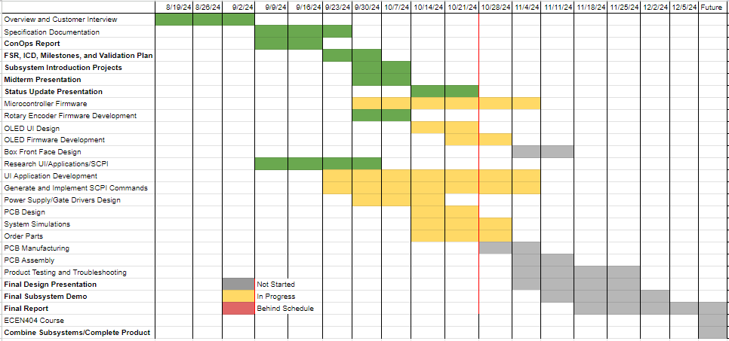
Execution Plan

Slide 15
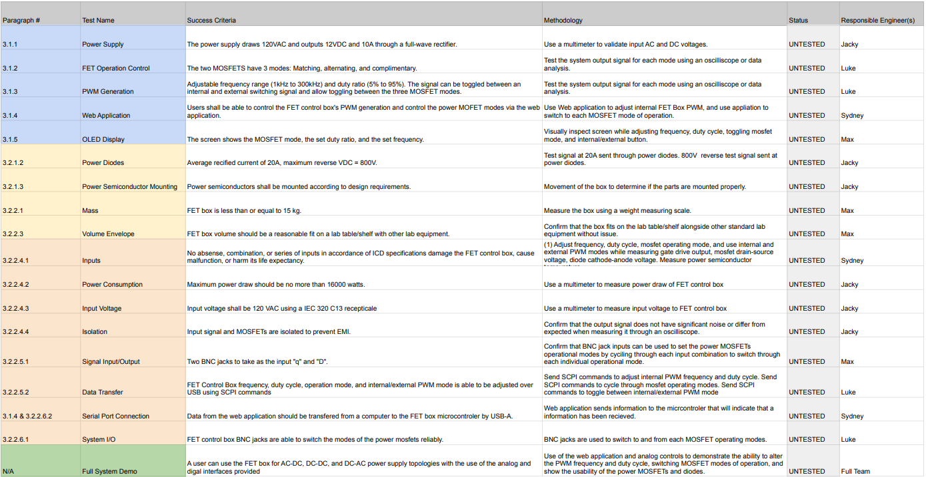
Validation plan

